Slide 1
Forecast the Supersubstorm Using the Machine Learning Technique
Yiwen Zhu
2021 April 5th

Slide 2
Why Studying the Supersubstorm (SSS)
SSS’s been pointed out to result in strong ionospheric and atmospheric effects which often extends to low latitudes.
Little attention’s been paid to the role of SSS in causing the space weather damage.
Study of the SSS helps us to understand the physics in the space.

Slide 3
The Definition of Supersubstorm
A substorm.
sharp decrease of SML for more than 45 nT in 3 min, maintenance of SML below 100 nT of the initial value for the subsequent 26 min.
SML (instead of AL) peak over -2500 nT.

Slide 4
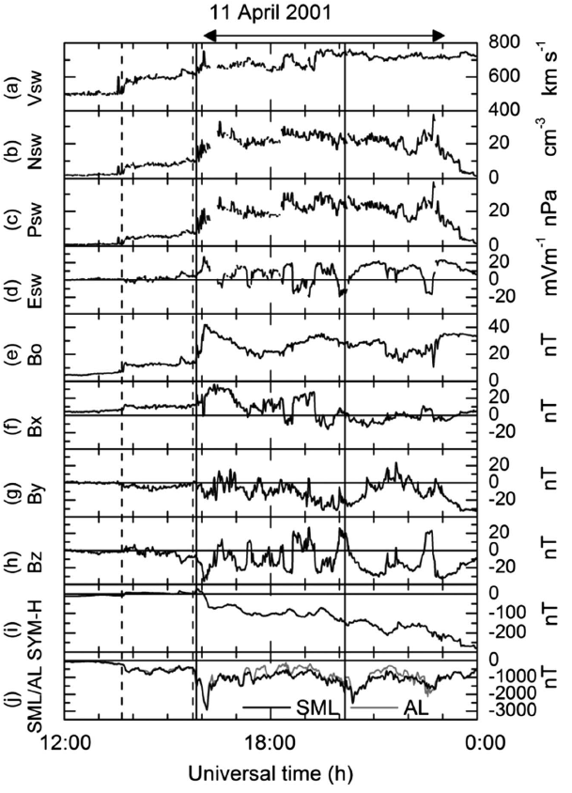
Case study of SSS

Slide 5
SSS peak separation
About 63% of the SSS’s peak SML values are separated by more than 6 h. 15% are separated by ~1 to 6 h, and ~22% are separated by less than 1h.(1981–2012)

Slide 6
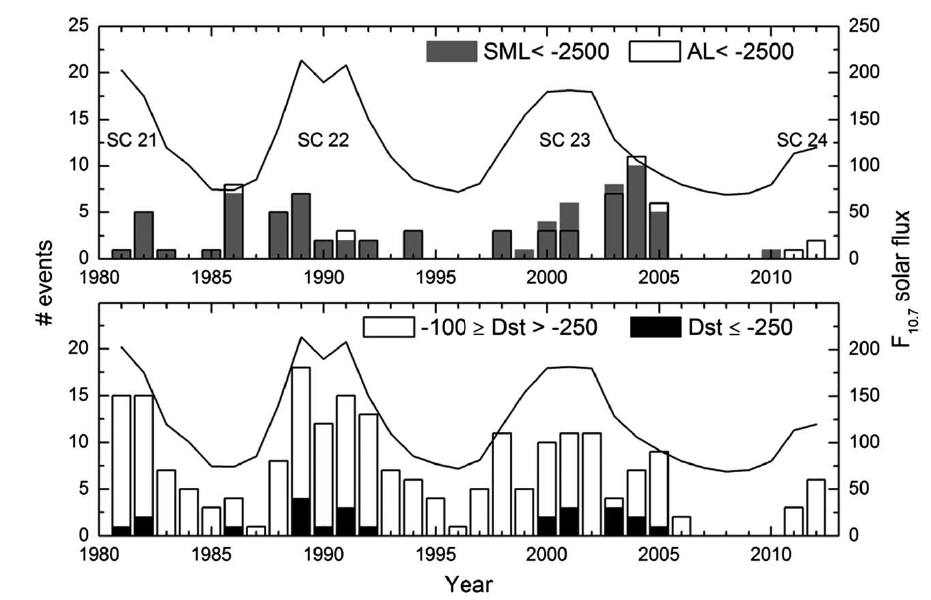
Dependence of Solar Cycle

Slide 7
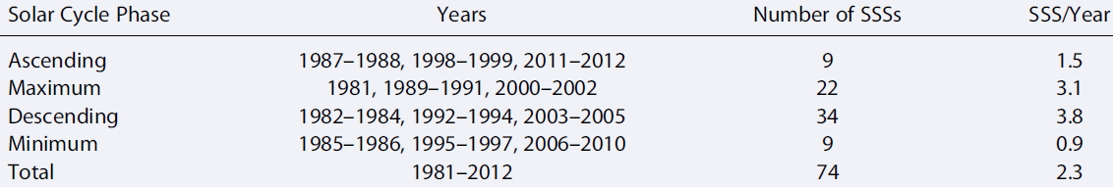
Dependence of Solar Cycle
The SSS events can occur during all phases of the solar cycle
Frequent during solar descending phase and solar maximum, rare during ascending phase and solar minimum

Slide 8
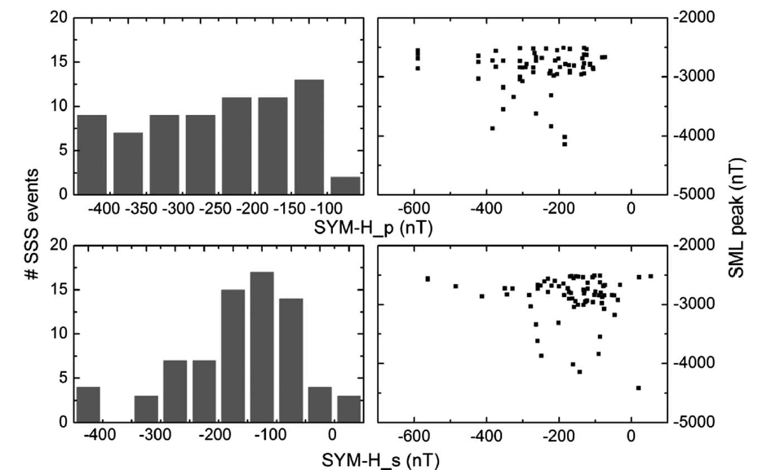
Dependence of Geomagnetic Storm

Slide 9
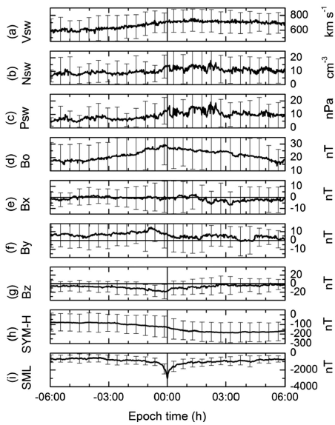
Dependence of Solar Wind Condition

Slide 10
Statistical Results
Separation greater than 1h.
Southern turning IMF Bz.
Increased solar wind velocity, pressure and density.

Slide 11
Dataset
SuperMag for SML
OMNI for solar wind conditions data

Slide 12
Dataset for three purposes

Slide 13
Machine Learning Method

Slide 14
Results analysis—Permutation Importance

Slide 15
Results analysis—Principle Components Analysis (PCA)

Slide 16
Comparison with Physics Model (RCM)

